Slide 1
Exploring the Possibilities of Transistors, Programming Languages, Hackathons, and Open Source Internships
An Initiative by
Dr Rajasekhar Reddy
Ho
HOD of computer & Engineering
NBKRIST

Slide 2
Introduction to Transistors
Programming Languages
Hackathon
Open Source
Open Source Internships

Slide 3


Processor
Central processing unit (CPU)
Executes instructions
Arithmetic and logic operations
Control unit coordinates processing
Clock speed affects performance

Slide 4

Transistor
Definition: What is a transistor storage element?
Advantages: Why use transistor storage elements?
Functionality: How do transistor storage elements work?
Types: What are the different types of transistor storage elements?
Applications: Where are transistor storage elements used?

Slide 5

Introduction to Programming
Programming is creating instructions that a computer can execute.
Basic concepts and syntax
Control structures and data types
Algorithms and problem-solving
Modular programming and functions
Debugging and testing

Slide 6
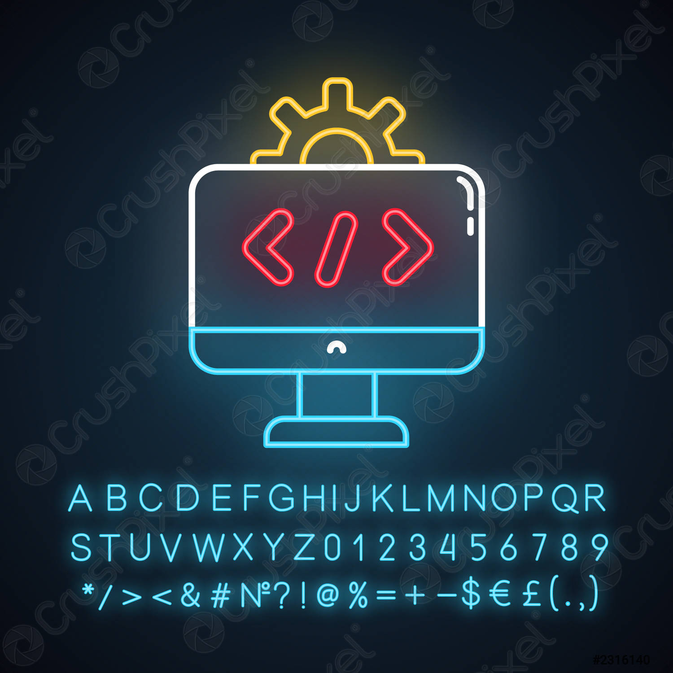
What is a Framework?
Reusable code.
Makes development faster.
Provides structure and organization.
Built on top of programming language.
Often used for web development.

Slide 7
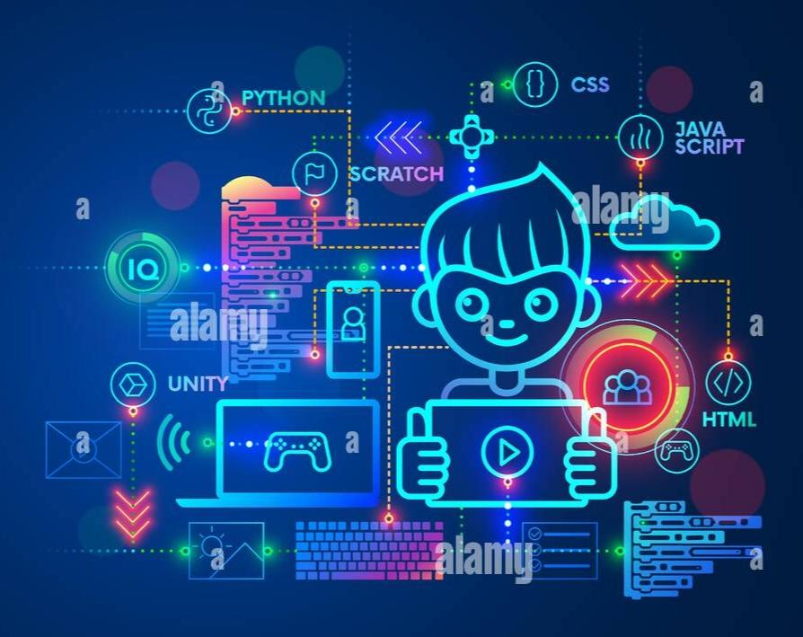
Why Are There So Many Programming Languages?
Different languages for different tasks.
Evolution of technology.
Personal preference of developers.
Niche markets and specialties.
Experimentation and innovation

Slide 8
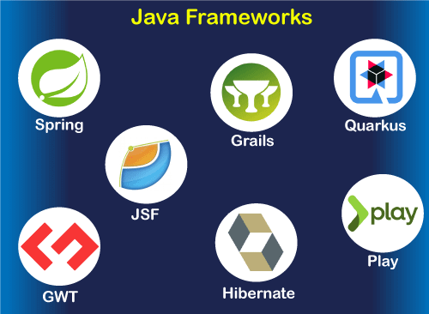
Java and Its Frameworks
Java is also an object-oriented language designed to create objects for applications.
Java frameworks such as Spring, Hibernate, and Struts provide tools and libraries for fast and efficient application development.

Slide 9
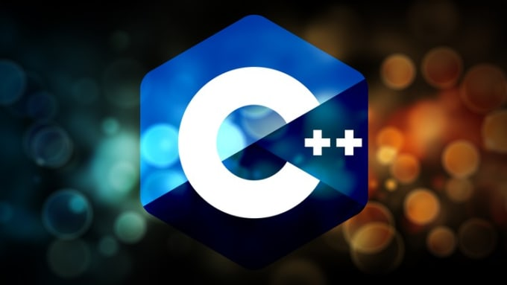
C++ and Its Frameworks
C++ is a powerful programming language used for high-performance applications.
It can be challenging to learn, but offers control over hardware resources.
C++ frameworks like Qt, Boost, and MFC provide libraries and tools for efficient application development.

Slide 10
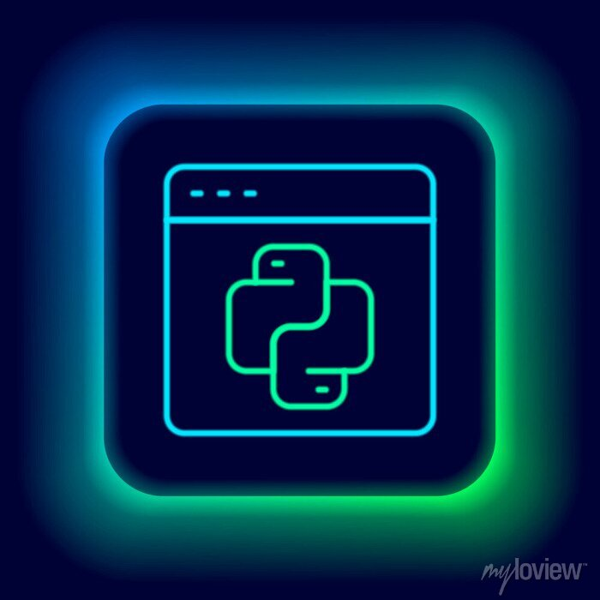
Introduction to Python
Python is a simple and easy-to-learn high-level programming language.
It is used for a variety of applications, such as web development, data analysis, and artificial intelligence.
Python is an interpreted language, meaning it can run on any platform without compiling.

Slide 11
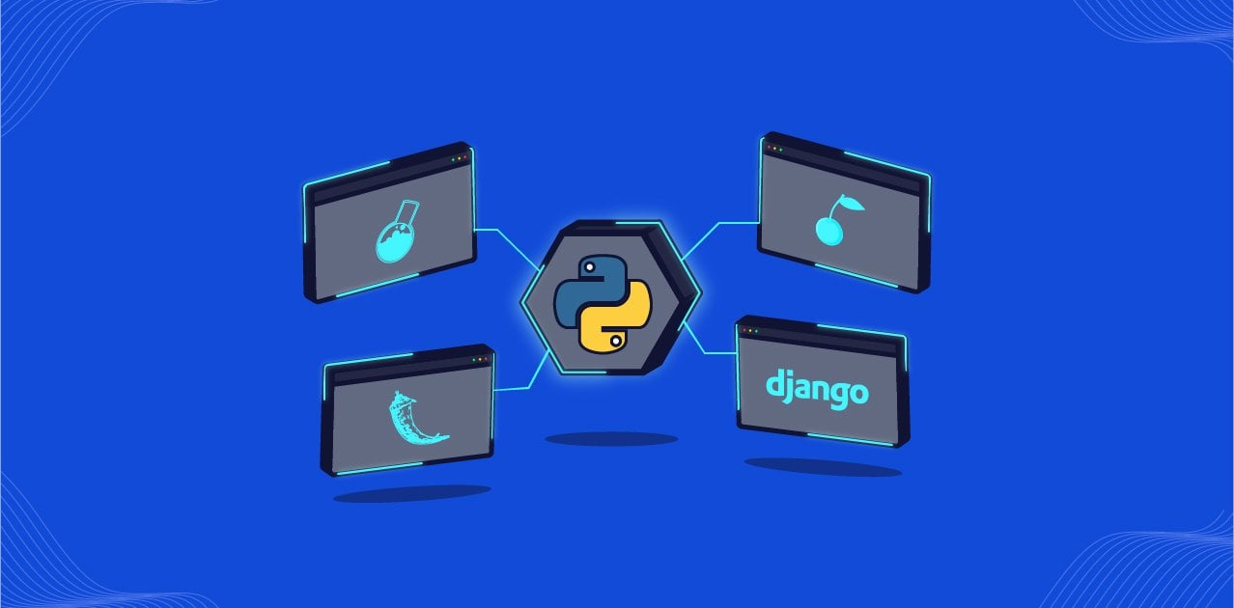
Python Frameworks
Django is a full-stack framework for building complex web applicatins
Pyramid is a flexible and scalable framework for developing web applications
CherryPy is a minimalistic framework

Slide 12
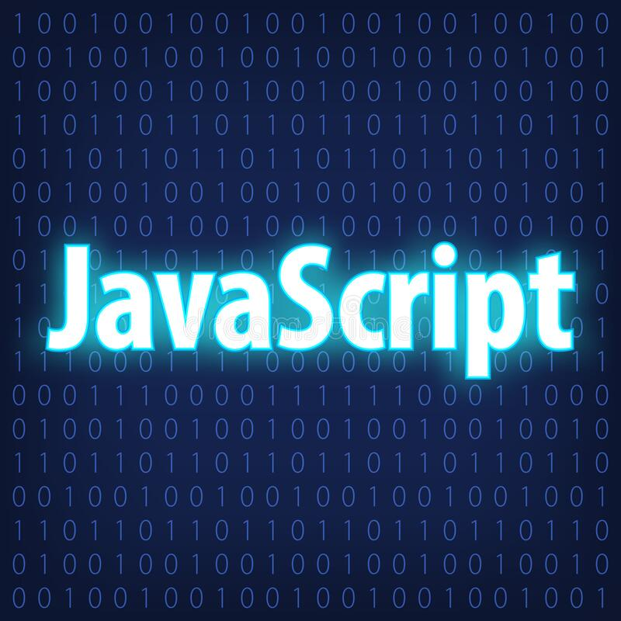
What is a Scripting Language?
A scripting language is a type of programming language used to write scripts that automate tasks.
Scripting languages are usually easier to read and write than low-level languages like assembly language.

Slide 13
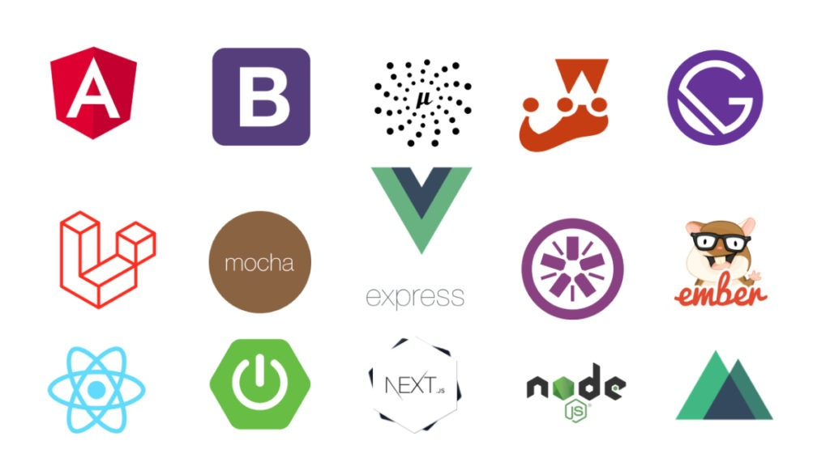
What are Javascript Frameworks?
Popular JavaScript frameworks include React, Angular, Vue.js, and Ember.
React is a popular framework for building user interfaces and web applications.
Angular is a comprehensive framework for building large-scale web applications

Slide 14
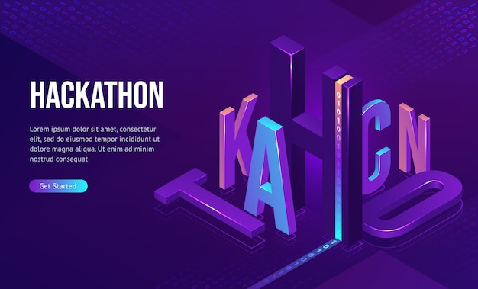
What is a Hackathon?
A hackathon is an event where people work on software projects together.
Participants work on projects for a set amount of time, usually 24 hours or more.
Hackathons are often focused on a specific theme or problem.

Slide 15
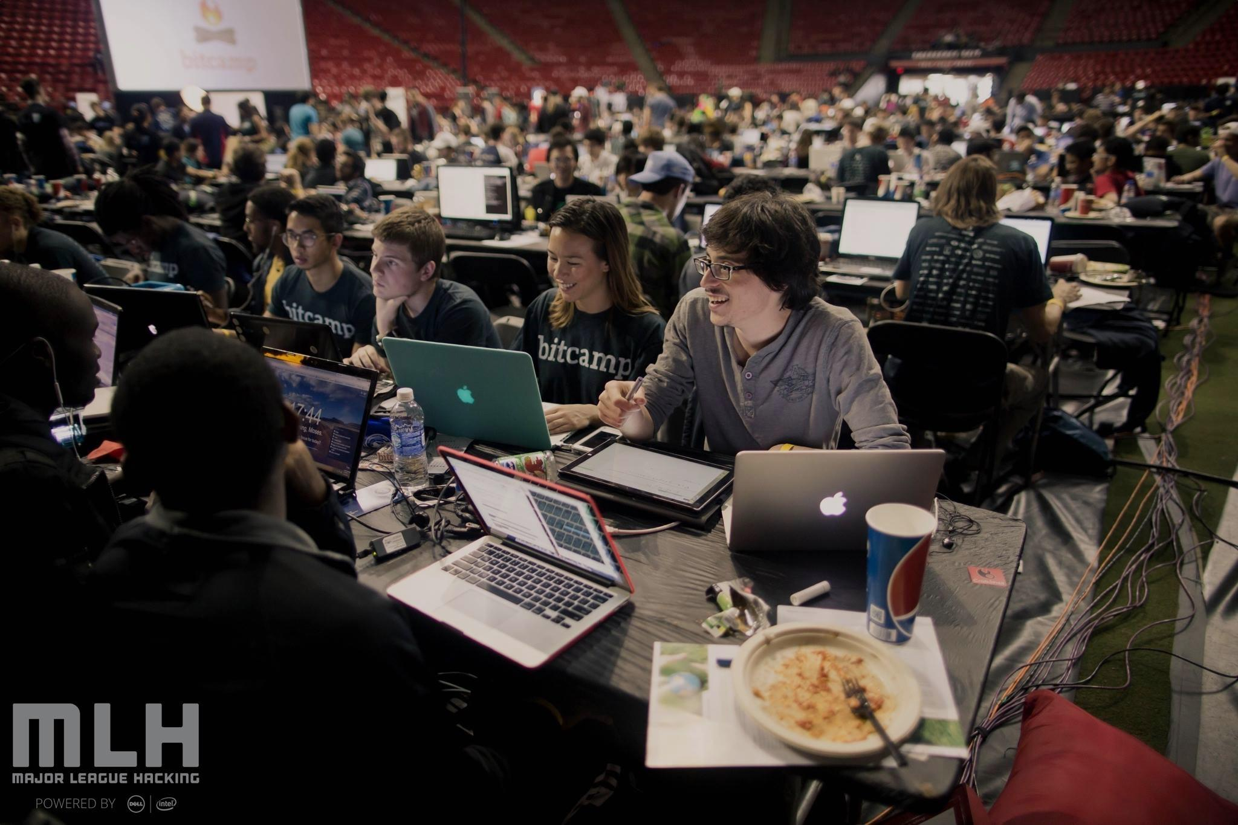
MLH Hackathons
Student-focused hackathons organized by MLH.
24-48 hours to work on software projects.
Free to attend with workshops and mentorship
Partnered with universities and companies with prizes for winners.

Slide 16
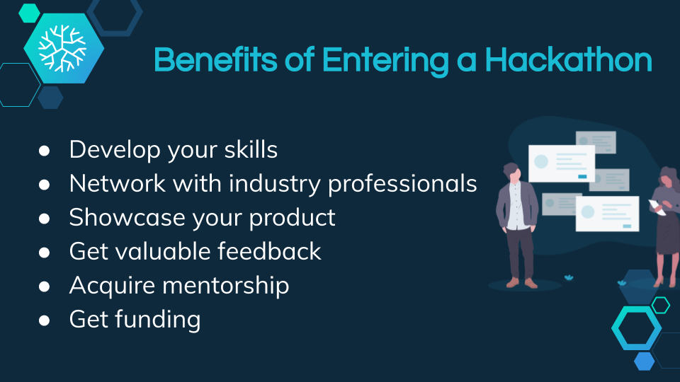
Benefits of Hackathons
Opportunity to learn new skills and network with peers.
Great opportunity to learn new skills and technologies.
Chance to work collaboratively with others.
Provides a platform to turn ideas into working prototypes.

Slide 17

How to Prepare for a Hackathon
Familiarize yourself with the event schedule and rules.
Research the event theme and any potential sponsors.
Brush up on relevant programming languages and technologies.

Slide 18

Tips for Winning a Hackathon
Make sure your project has a clear purpose and value
Showcase your project's potential and scalability
Practice a clear and concise pitch with a strong demo.

Slide 19

Introduction to Open Source
Open source is a type of software with publicly available code.
Allows developers to view and modify the code for their purposes.
Typically free to use and distribute.

Slide 20

Git and Github
Git is a version control system for tracking code changes.
GitHub is a web-based platform for hosting and collaborating on Git repositories.
Allows multiple developers to work on the same codebase.
Offers features like branching, merging, and pull requests for collaboration.

Slide 21

Open Source Programs
Open source internships involve contributing to open source projects.
Interns work remotely with a mentor or team.
Provides practical experience with real-world projects.
Offers opportunities for networking and career development.

Slide 22

Amazon Wow
Duration: 12 weeks
Skills Required: High-level programming language proficiency, Data Structures, and Algorithms
Stipend: Approximately 70,000 to 1 lakh per month
Target Audience: Women in Tech

Slide 23

Microsoft Engage
Duration: 8-12 weeks
Eligibility: Only for second-year students
Prerequisites: Knowledge of programming language, data structures, and projects
Stipend: Around 1 lakh per month.

Slide 24

Summer of Bitcoin
Duration: 12 weeks
Eligibility: Open for all
Prerequisites: Solidity, Bitcoin, web3 technologies
Required skills: Good GitHub profile, experience with open source contributions
Stipend: $1600-$3600 USD

Slide 25

Google Summer of Code
Duration: 10-14 weeks
Eligibility: Open for all
Required skills: Good GitHub profile, strong problem-solving skills, ability to work in a team
Stipend: $1800-$3600 USD (exact amount varies by region)

Slide 26
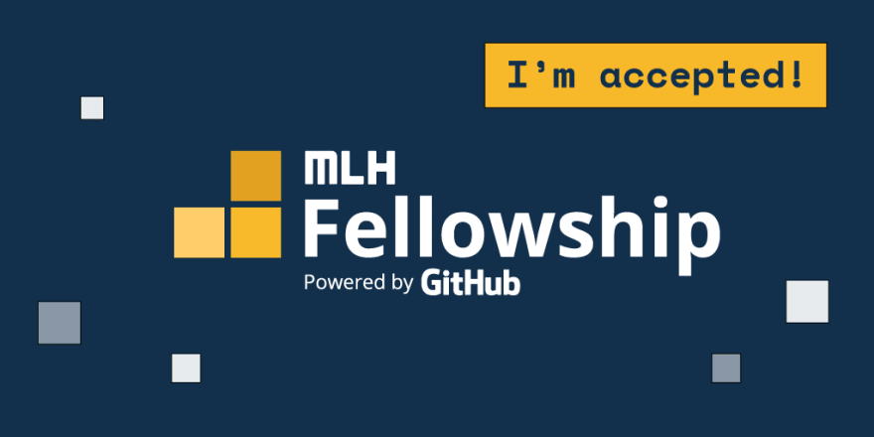
What is MlH Fellowship?
Duration: 12 weeks
Pre-requisites: Programming skills in any language and a project portfolio
Stipend: $5,000 USD
Program highlights: Open source contribution, industry mentorship, community building, and skill Development

Slide 27

What is Outreachy Internship?
Duration: 12 weeks
Eligibility: Open only for women, LGBTQ, and people belonging to backward castes
Prerequisites: None, but prior programming knowledge is beneficial
Required skills: Basic programming concepts, good communication and teamwork skills
Stipend: $7000 USD

Slide 28

What is Google Step Intern?
Duration: 10-12 weeks
Eligibility: Only for second year
Required skills: Good GitHub profile, strong problem-solving skills, ability to work in a team
Stipend: 70k-1Lakh

